Slide 1
Class 14: Information Theory
Part 1: Continuation of Shannon’s paper
Part 2: Determining authorship of The Federalist by Mosteller and Wallace

Slide 2
Continuing Shannon’s paper

Slide 3
Shannon’s key idea
A discrete information source is characterized by the probabilities for emitting signals from the source

Slide 4
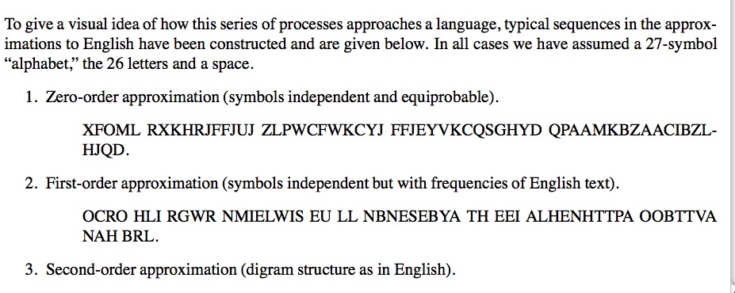

Slide 5
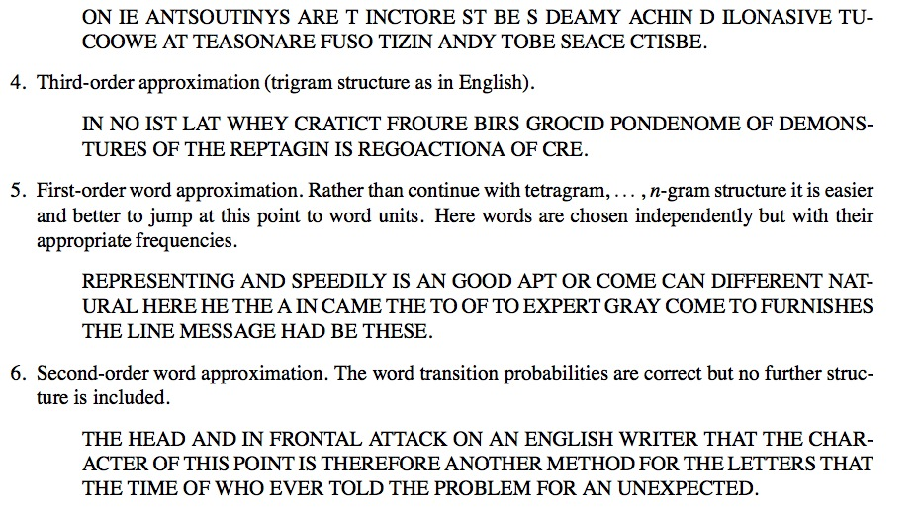

Slide 6
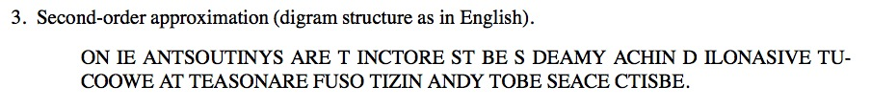

How to simulate the digram structure

Slide 7
Measuring information content
Suppose we have syllables with probabilities $p_{1},p_{2},…, p_{N}$
How much choice do we have in the selection a word?
How uncertain are we of the outcome?
Entropy – measure of disorder or uncertainty in a system
Maximum entropy example
toss a fair coin many times; no way to predict outcome of next toss
Minimum entropy example
toss a two-tailed coin many times; outcome is certain, next toss is tails
Notes:
Idea from physics
How much information is expressed by the information source?
How can we mathematically characterize the information content
in this source?

Slide 8
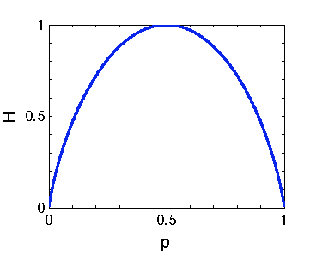
Measuring information content
Shannon Entropy
Example (N = 2)
H = 0 only if p = 0 or p = 1. Does this make sense?
H attains it’s maximum value at p = ½. Does this make sense?
Notes:
Shannon entropy – average information content of a source
Makes sense – in these cases we are certain of outcome – we gain no information
Makes sense – the most uncertain case

Slide 9
Measuring information content
Shannon Entropy
Measures the average information content of a source
When you utter a word, how many other choices of words
are you choosing between? Can you calculate this?

Slide 10
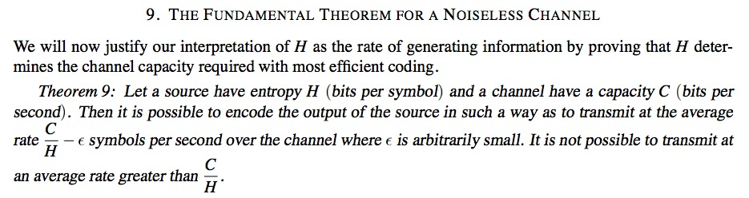
Shannon’s fundamental theorem
Suppose the information source has entropy H and the channel has capacity C
One can encode the output of the source so that it can be transmitted a rate of up to C/H symbols per second
It is not possible to transmit faster than C/H !!

Slide 11
Historical mystery
Who wrote the Federalist papers?

Slide 12
The Federalist
85 articles published in New York advocating the ratification of the US constitution during 1787–1788
Used in many court cases as a way to interpret the Founding Fathers’ intentions about the constitution
Authorship was a closely guarded secret (written under the pseudonym Publius)

Slide 13
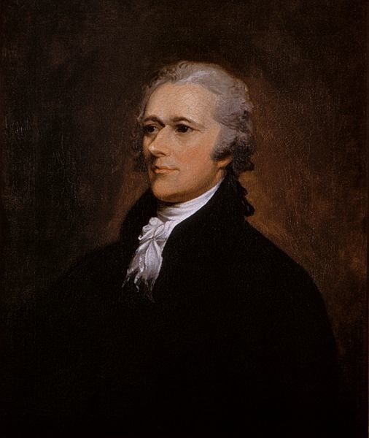
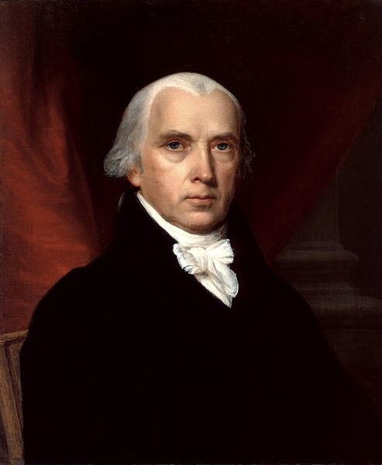
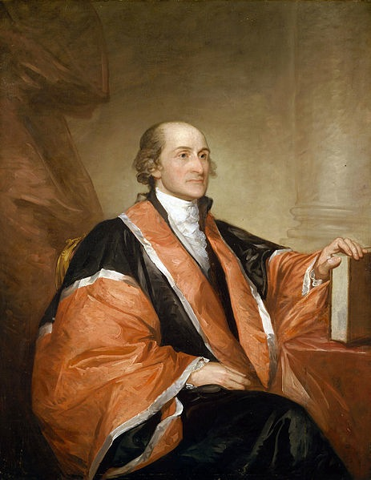
Suspected authors
Alexander Hamilton
(1757–1804)
James Madison
(1751–1836)
John Jay
(1745–1829)

Slide 14
Disputed authorship
Soon before his fatal gun duel, Hamilton provided a list claiming authorship of 63 of the articles (with three jointly written with Madison)
Later, Madison claimed 29 for himself, suggesting that the difference was “owing doubtless to the hurry in which [Hamilton’s] memorandum was made out”
Hamilton’s list contained at least one known error, attributing No. 54 to Jay, when in fact Jay wrote No. 64
How can the authorship of the articles be determined?
Notes:
Fatal gun duel link?
https://youtu.be/OLSsswr6z9Y
And
https://en.wikipedia.org/wiki/Burr–Hamilton_duel

Slide 15
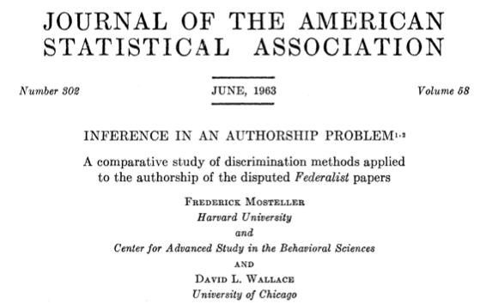
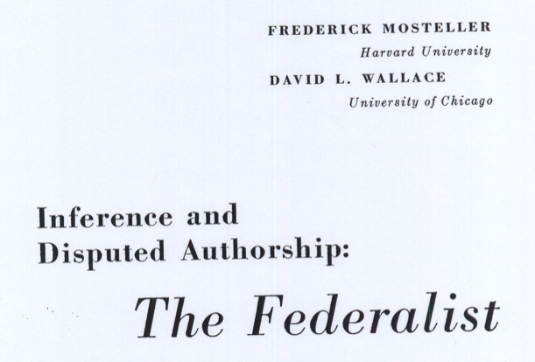
An information theory approach
by Frederick Mosteller and David L. Wallace
Notes:
Baseball!
Authorship paper is 1963, baseball paper is xx
Applied Bayesian and Classical Inference: The Case of The Federalist Papers
By F. Mosteller, D. L. Wallace

Slide 16
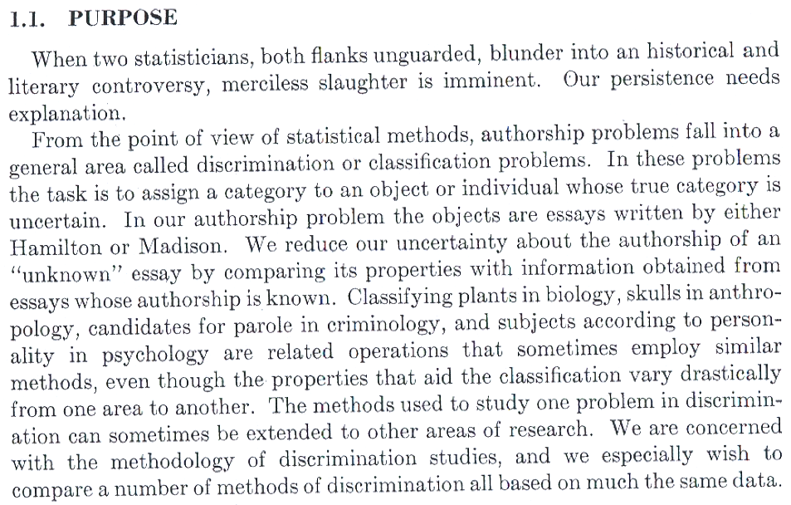
Notes:
Paper is quite humorous.
compare unknown texts to known
use several methods of “discrimination”

Slide 17
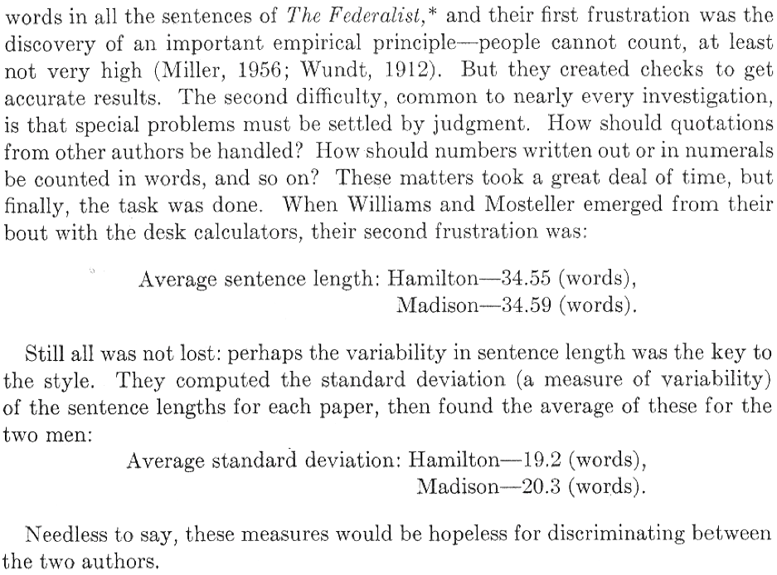
Approach #1: Wordiness
Notes:
People can’t count
Count the number of words in sentences

Slide 18
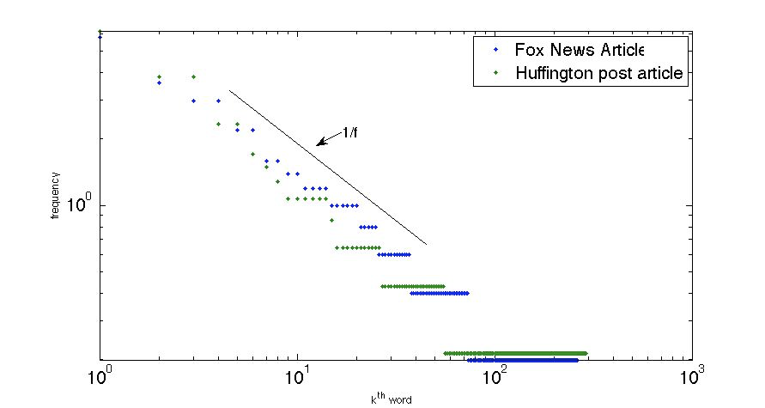
Approach #2: Zipf’s law
Frequency of word is inversely proportional to rank in frequency table
Notes:
Zipf's law states that given some corpus of natural language, the frequency of any word is inversely proportional to its rank in the frequency table. Thus the most frequent word will occur approximately twice as often as the second most frequent word, three times as often as the third most frequent word,

Slide 19
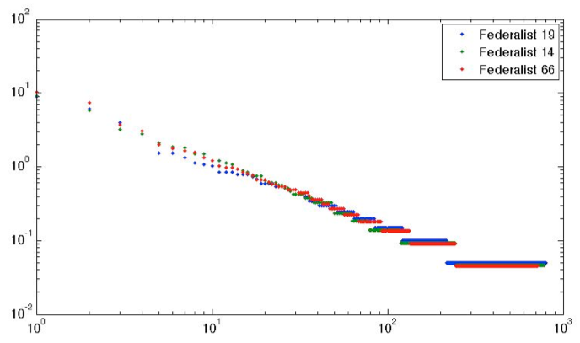
Approach #2: Zipf’s law
66 by Hamilton
14, 19* by Madison
Frequency
Word
Notes:
Zipf's law states that given some corpus of natural language, the frequency of any word is inversely proportional to its rank in the frequency table. Thus the most frequent word will occur approximately twice as often as the second most frequent word, three times as often as the third most frequent word,
19 was considered jointly written in paper
So, naturally: the most common words
do not give any information about authorship.
Indeed, they don’t even allow us to distinguish different
types of texts very well!

Slide 20
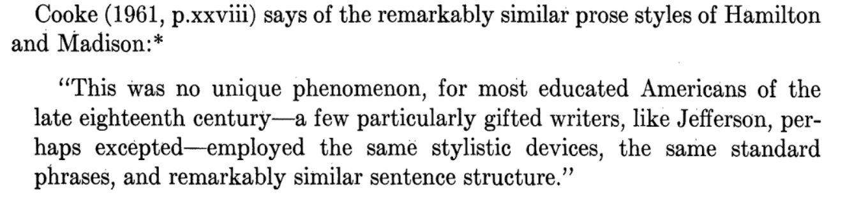
Approach #2: Zipf’s law
Applied Bayesian and Classical Inference: The Case of The Federalist Papers
By F. Mosteller, D. L. Wallace

Slide 21
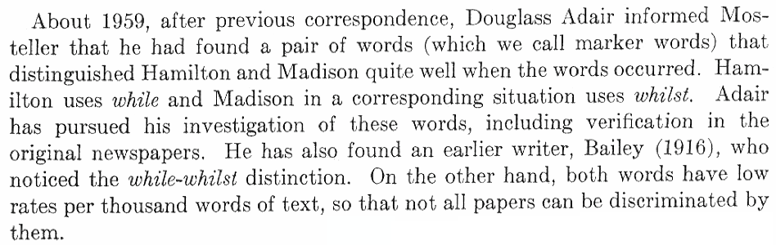
Approach #3: look for special words
Experts in the field had considered this, but did not see how to use this to determine authorship with certainty
But Mosteller and Wallace pursued it in the hope that with enough markers the evidence would become overwhelming

Slide 22
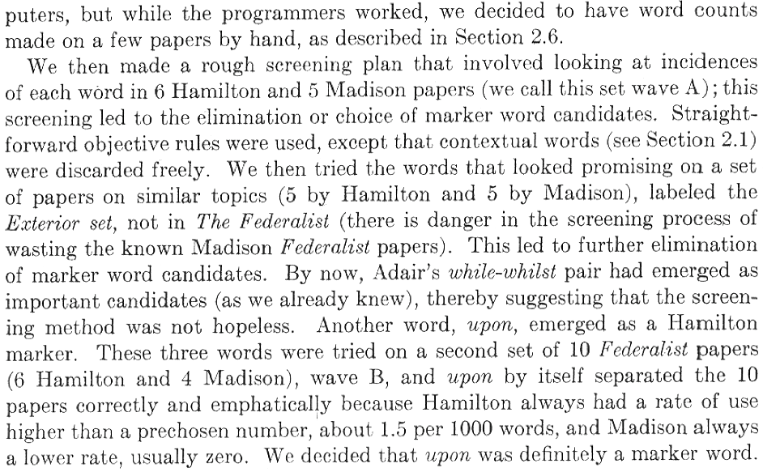
Mosteller and Wallace’s approach
Notes:
How do you choose “marker words”?
—> Screening through texts of known authorship

Slide 23
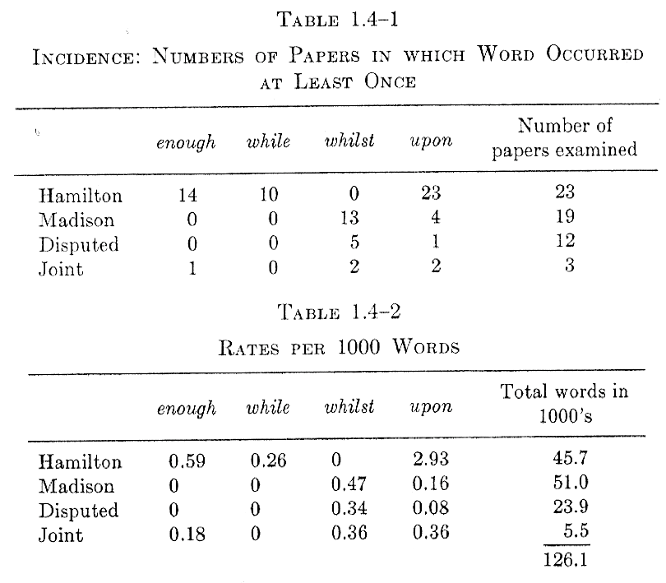
Tabulated data

Slide 24
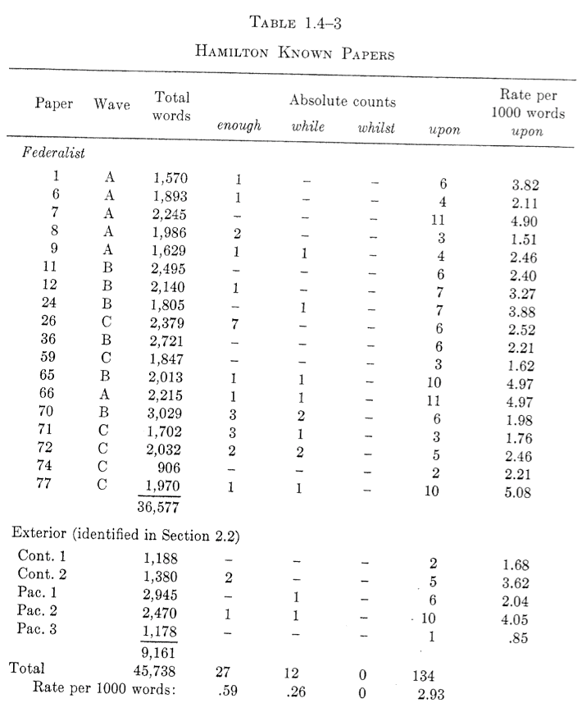
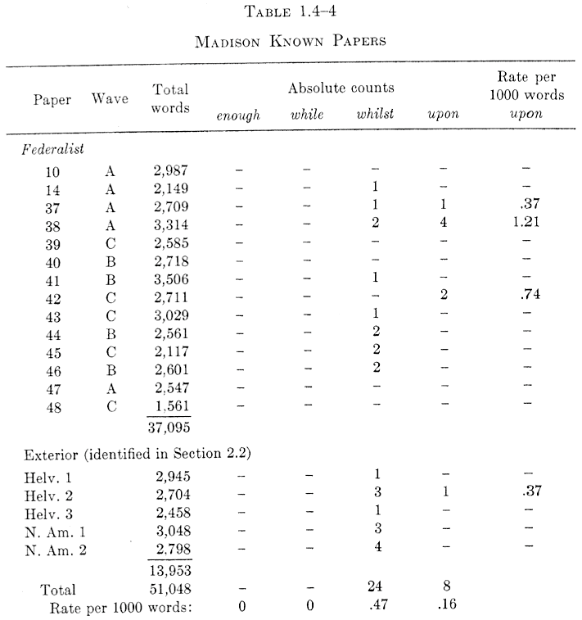
Systematic study
Hamilton
Madison

Slide 25
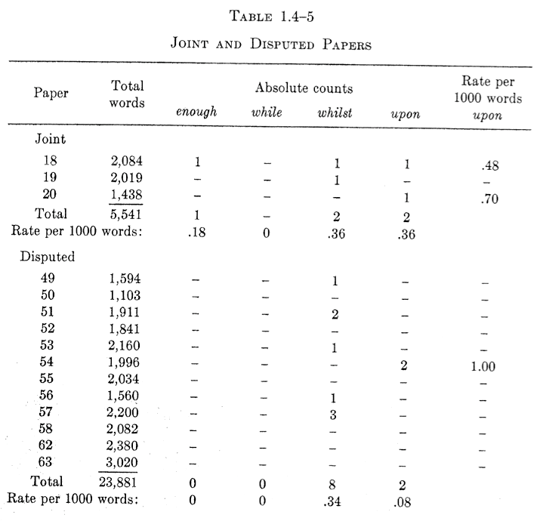
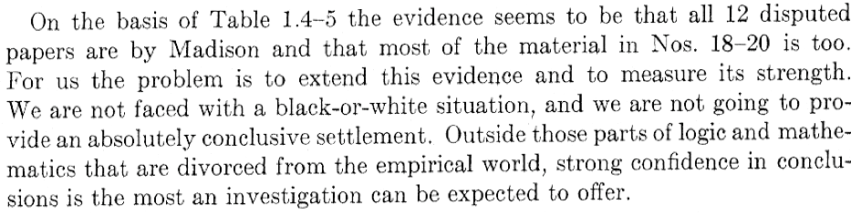

Slide 26
Getting more specific
How can we ascribe an actual probability that a given paper is written by Hamilton and Madison?
A random variable X follows a Poisson distribution if
A good model? The total number of occurrences of a particular word in a given paper follows a Poisson distribution
Notes:
Poisson probability is good for rare events … rare words!
X = number of hospital births/hour
Births occur at an average rate of 1.8/hour
What is the probability of observing 4 births in an hour?
P(X = 4) = e^-1.8 * 1.8^4/4! = 0.0723
Event can occur 0, 1, 2, … times in an interval. mu = average number of events per interval, the event rate.

Slide 27


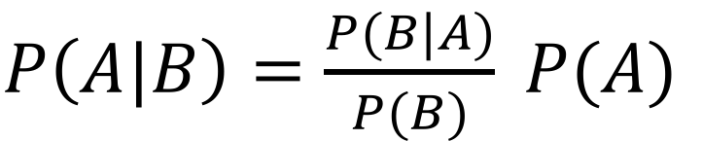
Bayes’ Theorem
Let A be the event that you have a rare disease, and B be the probability that you test positive for this disease
The probability of
Similarly, and hence
$$P\left(A, B\right)=P\left(A\right)P(A|B)$$
Probability of A happening given that B happened
Joint probability of both events
$$P\left(B, A\right)=P\left(B\right)P(B|A)$$
$P\left(A|B\right)=\frac{P(B|A)}{P(B)} P(A)$
Posterior – my estimate of having disease, given the positive test result
Prior – my initial estimate of having disease
Notes:
P(A,B) = probability of both testing positive for the rare disease and actually having it
P(A|B) = probability of having rare disease given that you tested positive
P(A) = probability of having disease
P(B) = probability of testing positive for disease
P(B|A) = probability of testing positive for disease given that you have the disease (true positive)

Slide 28
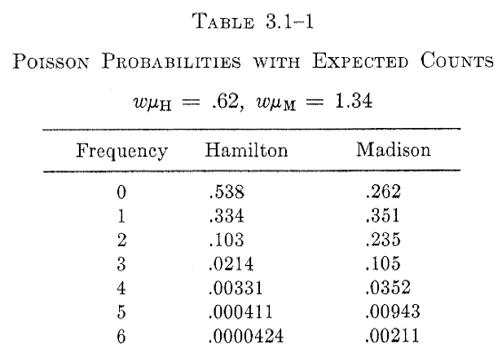
Example: “also”
Expected number of occurrences
w = word count in 1000s
𝜇 = rate per 1000 words
2000 total words
Let H be the event that Hamilton wrote the paper, and let M be the event that Madison wrote the paper
Suppose that “also” is used 4 times a paper. What are the odds that Hamilton wrote the paper?
𝜇H = 0.31
𝜇M = 0.67

Slide 29
Two interpretations
Ratio of probabilities (“likelihood ratio”)
Hence you might say that the odds are 10:1 that Madison wrote the paper.
But this depends on what your prior belief about who wrote the papers is.
If you had other reasons to think Hamilton wrote the paper, you might feel differently.

Slide 30
The use of Bayes’ Theorem
From Bayes’ Theorem
Hence
Prior odds of Hamilton versus Madison
Posterior odds of Hamilton versus Madison
Probabilities estimated from Poisson model and observed data

Slide 31
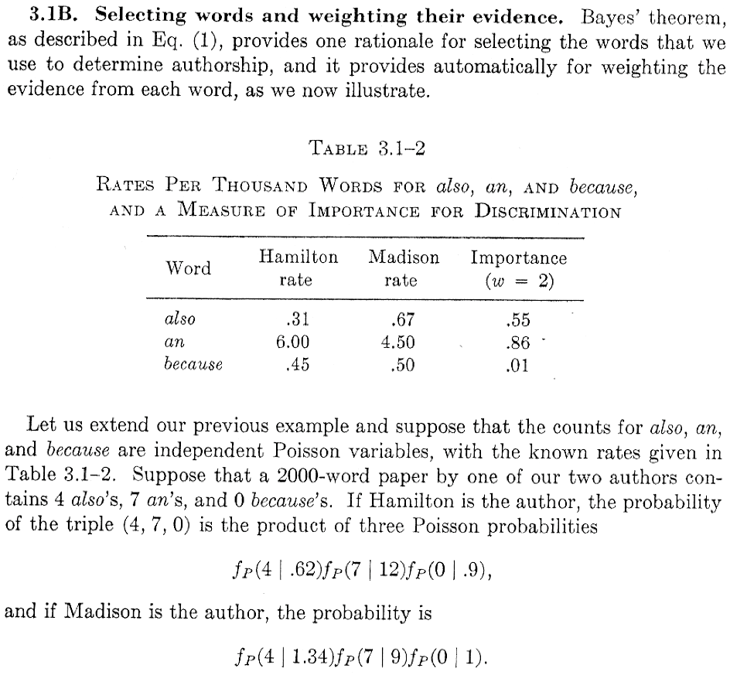
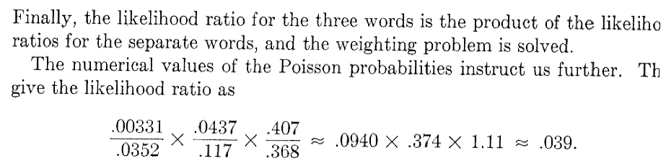


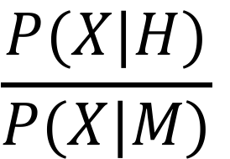

$$X$$
$$P(X|H)$$
$$P(X|M)$$
$$\frac{P(X|H)}{P(X|M)}$$
Notes:
Likelihood ratio for 3 words

Slide 32
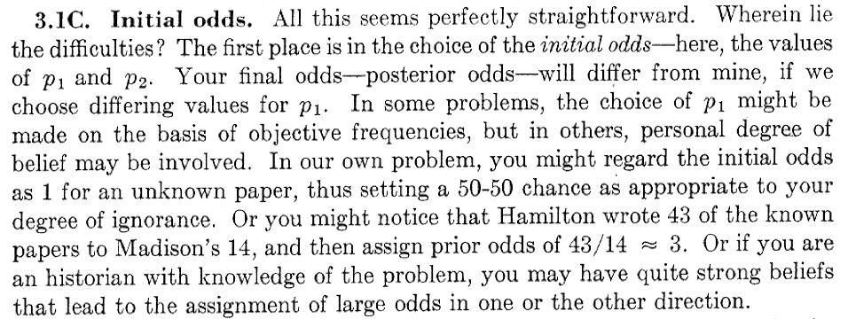
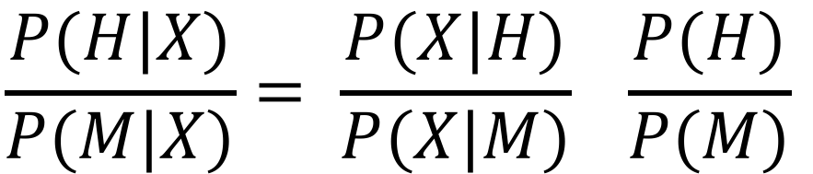

Subtleties
$$p_{1}=P\left(H\right) p_{2}=P(M)$$
$$\frac{P(H|X)}{P(M|X)}= \frac{P(X|H)}{P(X|M)} \frac{P(H)}{P(M)}$$
Notes:
Problem: choosing your priors

Slide 33
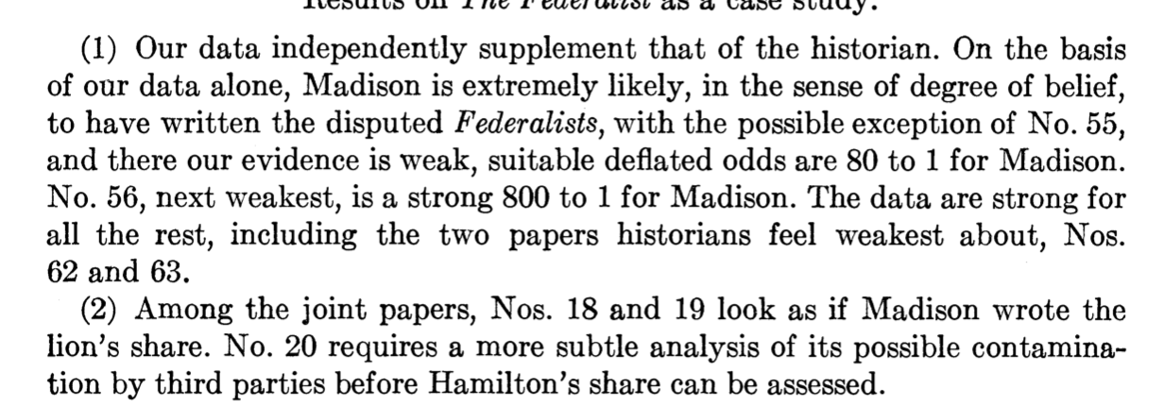
Conclusions
Notes:
Problem: choosing your priors

Slide 34
Measuring information content
What is the probability of the MOST probable word of N symbols?
Suppose we have a word with N symbols.
On average, there will be
occurrences of the first symbol
occurrences of the second symbol
…
Hence the probability of the word is

Slide 35
Measuring information content
The probability of the word is
In terms of Shannon Entropy
How many “most probable” words are there? About

